Slide 1
Sholo Ghuti
Course Title: Artificial Intelligence Laboratory
Course no: CSE 4110
Presented by-
Md.Asif-Ud-Daula(1707031)
Syed Nahin Hossain(1707032)
Mohtasim Fuad(1707033)

Slide 2
Outline
Introduction
Developing Tools
Basic concept
AI Algorithm
Conclusion
Reference

Slide 3
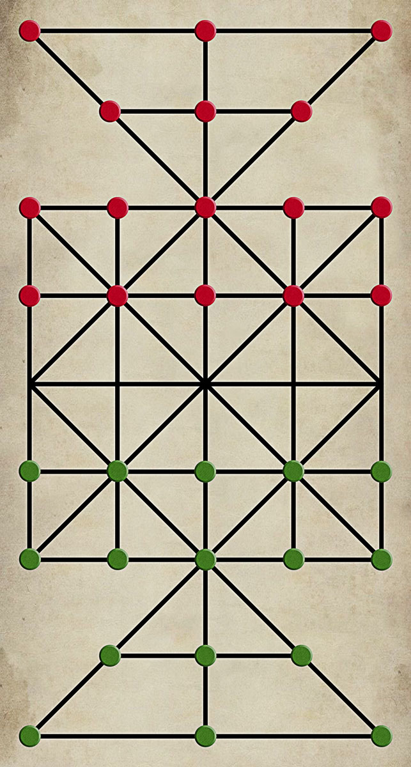
Introduction
Sholo ghuti is a very popular game in the countries of south
Asia. It is a game of two players, each players has 16 beads
called ghuti. The player who captures all of the other
player's pieces wins the game. [1]

Slide 4



Developing Tools
Operating system : Windows 10
Language: Python 3.9
Library : Pygame

Slide 5
Basic Concept
Players alternate their turns
A player may only use one of their pieces in a turn, and must either make a move or perform one or more capture but not both.
A piece may move onto any vacant adjacent point along a line.

Slide 6
Basic Concept
A piece may capture an opposing piece by a short leap. The piece must be adjacent to the opposing piece, and leap over it onto a vacant point immediately beyond. The leap must be in a straight line and follow the pattern on the board.
The captured piece (or pieces) is removed from the board.
The player who captures all of the other player's pieces wins.

Slide 7
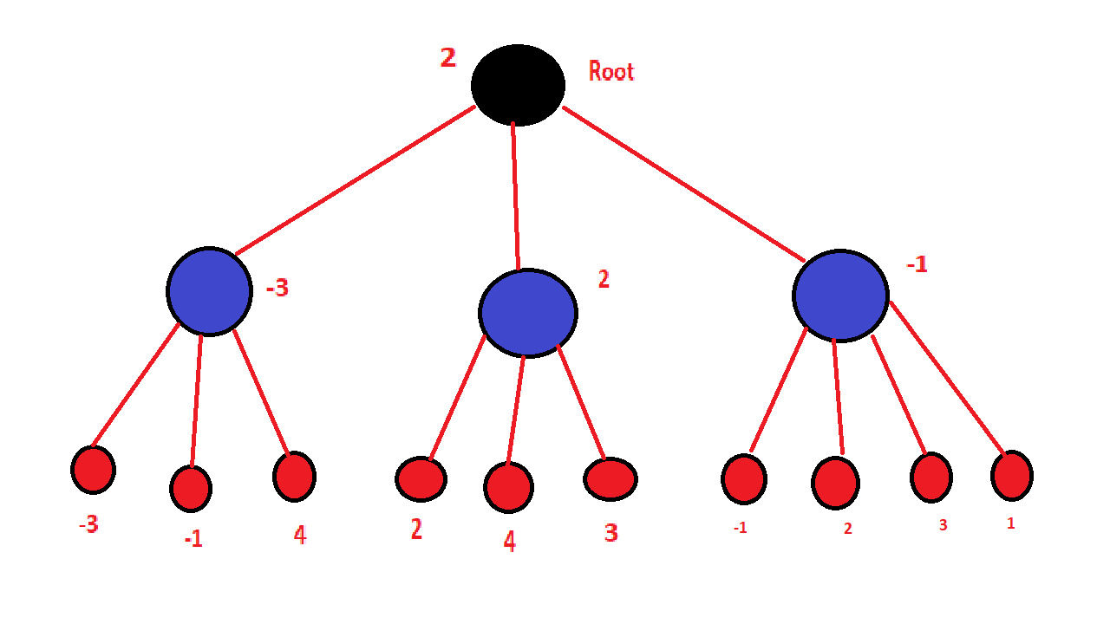
AI Algorithm
Mini-Max Algorithm.[2]
Score for AI will be the difference between player-1 pieces left and player-2 pieces left
If player-1 is AI, then player-1 will try to maximize the score but player-2 will try to minimize the score.
After checking all the possible turn AI will select the turn resulting the maximum score.

Slide 8
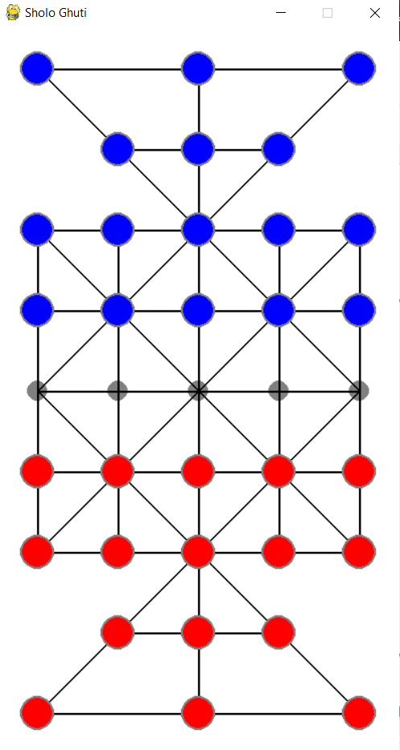
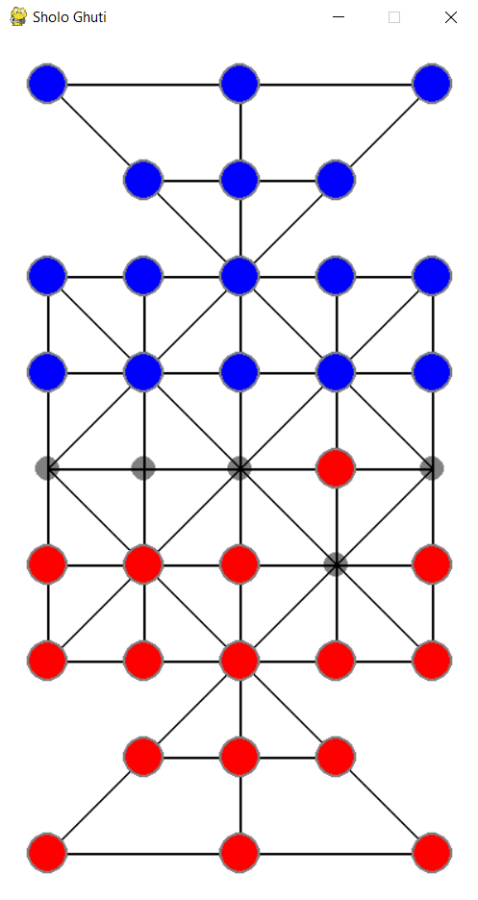
Game Screenshot

Slide 9
Conclusion
In this project , we tried to implement the mini-max algorithm in a two player game. The game we created will be able to highlight the performance of the algorithm as well as providing necessary entertainment to the player.

Slide 10
References
[1]https://bn.m.wikipedia.org/wiki/%E0%A6%B7%E0%A7%8B%E0%A6%B2_%E0%A6%97%E0%A7%81%E0%A6%9F%E0%A6%BF
[2]https://www.geeksforgeeks.org/minimax-algorithm-in-game-theory-set-1-introduction/

Slide 11
Thank you

